Slide 1
Advanced RFID Prototyping with the WISP 5.0
Aaron Parks
Saman Naderi Parizi
Sensor Systems Laboratory
University of Washington
http://www.github.com/wisp/wisp5

Slide 2
What is the Wireless Identification and Sensing Platform?
A fully programmable, software defined passive RFID sensor tag
Open source hardware, firmware, and host software.
An experimenter’s platform for RFID technology and applications.
Notes:
Show brief demo here

Slide 3
Our goals & motivations for WISP
To accelerate RFID and battery free platform development for researchers
Novel RFID applications
Novel protocols
Novel PHY layers
Software optimization for energy harvesting platforms

Slide 4
Question: What are your goals?
What interests you about the WISP?
In which application space would you potentially be applying WISP?

Slide 5
Outline
A brief history of the WISP
WISP Development Resources
Hardware Overview
Firmware Walkthrough BREAK
Interfacing with the Reader
Live demo: Application Development
Designing for Low Power
Notes:
Disclaimer: this is not an exhaustive tutorial on WISP, just an introduction to the tools and techniques of WISP5. We could write a full course on WISP!

Slide 6
Free hardware!
Qty 10 available today
Must have access to FCC compliant reader
More available June/July by request
(sign up today)

Slide 7
A Brief History of the WISP

Slide 8
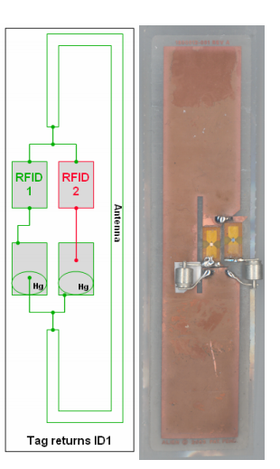
A brief history...
Intel Labs Seattle, 2005-2006
Josh Smith, Alanson Sample, Dan Yeager and others ask the question: Can passive RFID tags be sensors?
ID modulation as a means of data transfer.
…. lots of development time ...
Firmware implementation of EPC-compatible tag
Answer: Yes they can!http://www.youtube.com/watch?v=SKQ3wkAqA_8
alpha-WISP, with mercury tilt switches

Slide 9
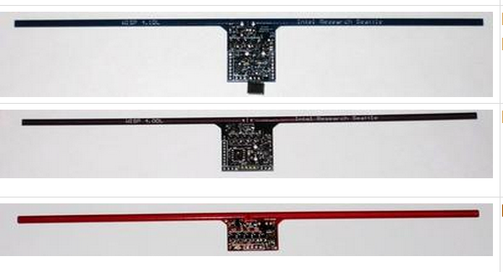
A brief history...
4.1
4.0
2.0

Slide 10
A brief history...
Intel Labs WISP 4.1 (Blue WISP)
The WISP Challenge
>40 groups collaborating worldwide
The WISP 4.1 Wiki
http://wisp.wikispaces.com

Slide 11
A very incomplete listing...
Of projects done by WISP Challenge recipients:
Elliptic Curve Cryptography on the WISP UHF RFID Tag, Christian Pendl, Markus Pelnar, and Michael Hutter; 7th Workshop on RFID Security (RFIDsec 2011); Amherst, Massachusetts, USA, June 26-28, 2011
Wireless Strain Measurement for Structural Testing and Health Monitoring of Carbon Fiber Composite, Federico Gasco, Paolo Feraboli, Jeff Braun, Joshua Smith, Patrick Stickler, and Luciano DeOto; Journal of Composites: Part A, May 14, 2011
Concealable, Low-Cost Paper-Printed Antennas for WISP-based RFIDs, Mauro Marroncelli, Daniele Trinchero, Vasileios Lakafosis, and Manos M. Tentzeris. 2011 IEEE International Conference on RFID. April 12-24
A Software Radio-based UHF RFID Reader for PHY/MAC Experimentation, Michael Buettner and David Wetherall. 2011 IEEE International Conference on RFID. April 12-24
Photovoltaic Enhanced UHF RFID Tag Antennas for Dual Purpose Energy Harvesting, Alanson Sample, Jeff Braun, Aaron Parks, and Joshua Smith. 2011 IEEE International Conference on RFID. April 12-24
Dewdrop: An Energy-Aware Runtime for Computational RFID, Michael Buettner, Ben Greenstein and David Wetherall. NSDI, March 2011.
Mementos: System support for long-running computation on RFID-scale devices, Benjamin Ransford, Jacob Sorber, and Kevin Fu. In Proceedings of the 16th Architectural Support for Programming Languages and Operating Systems (ASPLOS 2011), Newport Beach, CA, March 2011
Exploiting Half-Wits: Smarter Storage for Low-Power Devices, Mastooreh Salajegheh, Yue Wang, Kevin Fu, Anxiao (Andrew) Jiang, Erik Learned-Miller. In Proceedings of the 9th USENIX Conference on File and Storage Technologies (FAST 2011), San Jose, CA, February 2011.
See wisp.wikispaces.com/Publications for more

Slide 12
The WISP 5.0 story
WISP 4.1 served it’s purpose, but had limited capabilities
Limited data throughput
Very difficult to modify and extend firmware
Lack of support for READ/WRITE commands
Low capability microcontroller (e.g., no HW multiplier)
UMass introduces the MOO platform, with a more capable microcontroller...

Slide 13
The WISP 5.0 story
FPGA-WISP?
Actel Igloo series (static FPGAs) are very promising
A prototype was developed based on our verilog implementation of RFID state machine:
https://github.com/wisp/rfid-verilog
Good power efficiency when active.
Difficult to manage power in sleep states, etc.
Perhaps a hybrid MCU/FPGA system could work well?

Slide 14
The WISP 5.0 story
Sticking with the MSP430
Still has industry leading power/clock features
TI is always pushing the envelope: Now featuring: FRAM!
Extremely low energy non-volatile memory.
Big news for this duty cycled, energy harvesting platform.
New primary target platform for WISP 5.0: the FRAM-based MSP430FR5969 (“Wolverine”)

Slide 15
Two flavors of WISP 5.0
WISP5-LRG (prototypes available now)
The long-range WISP. Best sensitivity, but poor efficiency at high RF power levels (low reads/sec).
WISP5-HPW (coming soon)
The high-power WISP. Similar sensitivity to WISP 4.1, and good efficiency at high power levels (high reads/sec).

Slide 16
Licensing
BSD 2-Clause
Open source
OK to redistribute with non-open source software
Applies to software, firmware, and hardware design files.
The WISP 5 is associated with the University of Washington (no Intel ties).

Slide 17
WISP Development Resources

Slide 18
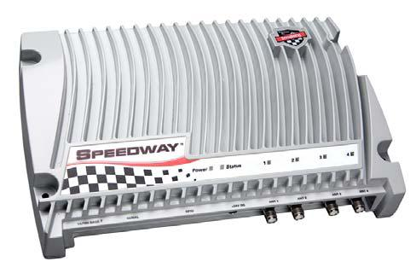
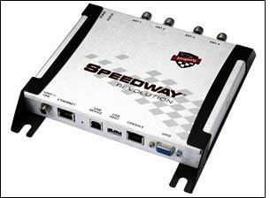
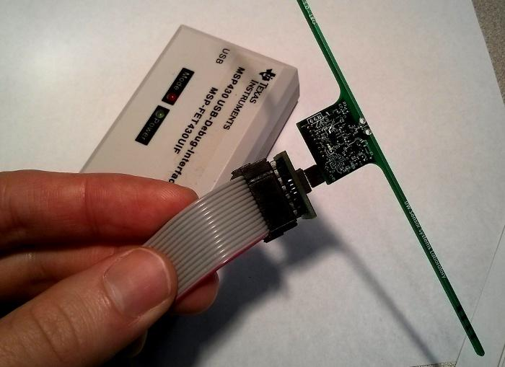
Hardware requirements
Impinj Speedway reader
R1000
R2xx/R4xx
Currently only compatible with FCC-compliant Impinj Speedway readers!!
MSP-FET430UIF debugger
WISP Programming adapter
-OR-

Slide 19
Software Requirements
TI Code Composer Studio (CCS v5.x)
IDE for MSP430 development
Available for Windows and Linux
We’re in the process of an MSPGCC port, but CCS is suitable for now. CCSv6 will use GCC backend.
Host side software
SLLURP library for interfacing with RFID readers

Slide 20
Hardware Overview

Slide 21
General Overview
RF-DC and Charge Storage
MCU (MSP430)
Sensors and Peripherals
Impedance Matching
Power ->
ASK Detector and Demodulator
<- Power
<- Data ->
RX ->
<- TX

Slide 22
Analog Front End & RF Recovery
Matching and RF-DC conversion
DC-DC charge pump
Charge storage

Slide 23
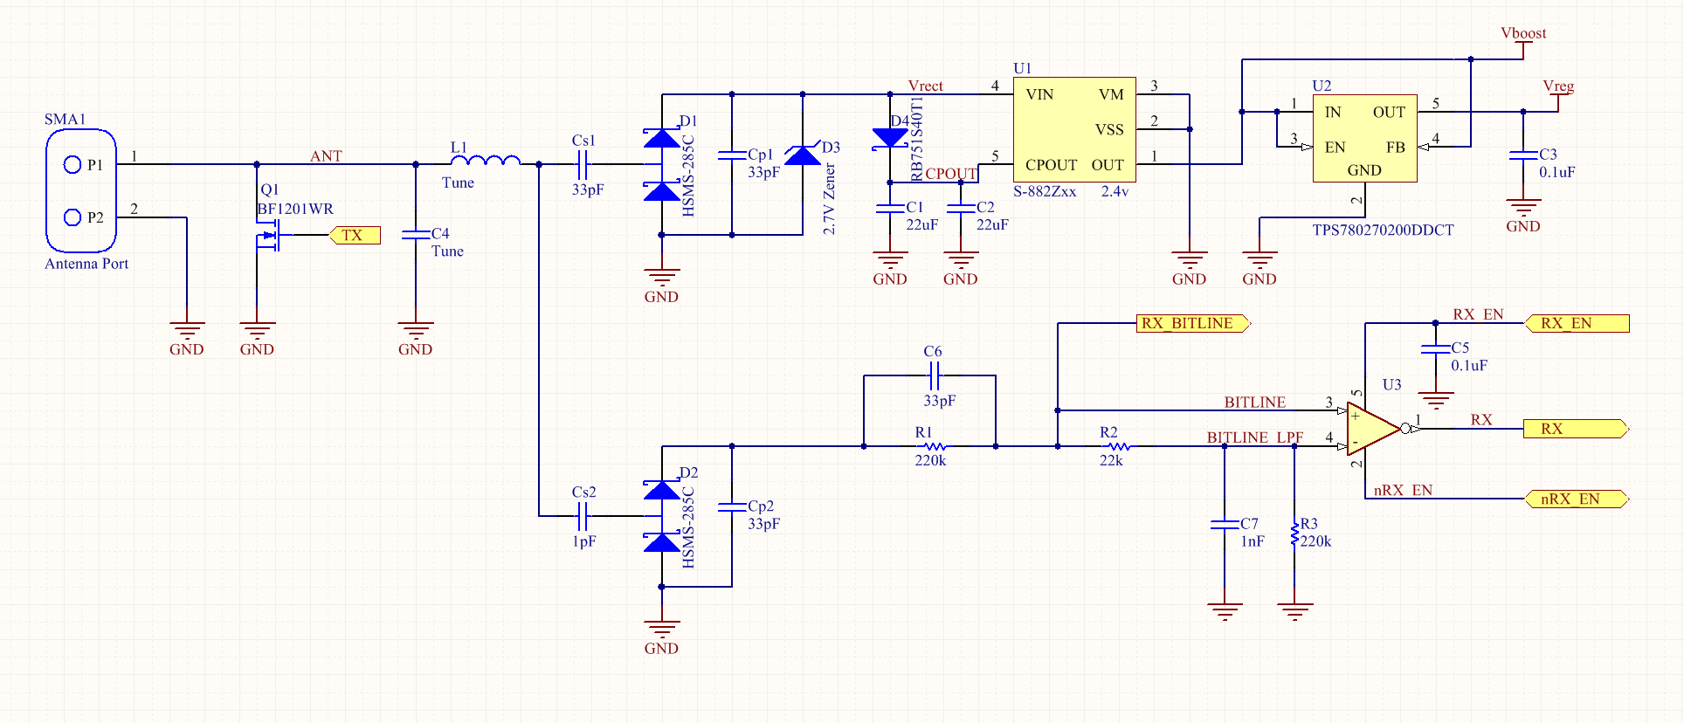
Analog Front End & RF Recovery

Slide 24
Analog Front End & RF Recovery
RF Matching & Modulation

Slide 25
Analog Front End & RF Recovery
RF Energy Recovery

Slide 26
Analog Front End & RF Recovery
DC-DC Conversion/regulation
Seiko S-882Z

Slide 27
Analog Front End & RF Recovery
Envelope Detector

Slide 28
Analog Front End & RF Recovery
ASK Demodulator

Slide 29
Energy harvesting operation
Duty cycling behavior
Due to ‘features’ of Seiko S-882Z charge pump, we have forced duty cycling.
WISP 5 HPW will not use the S-882Z
Developer will have ability to manage task scheduling.
Reduced sensitivity is the tradeoff (-9dBm vs -15dBm)

Slide 30
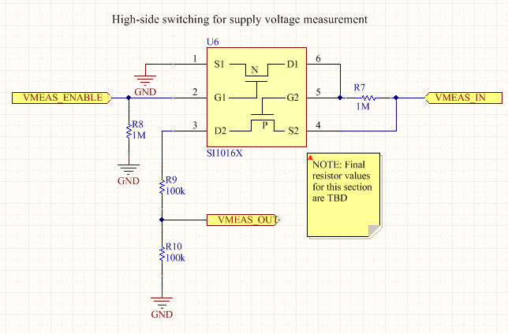
Sensors and Peripherals
Inbuilt temp sensor (MSP430)
Charge monitoring
Gated voltage divider for self supply measurement

Slide 31
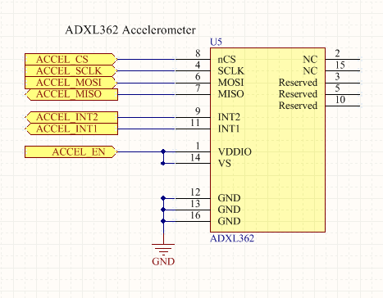
Sensors and Peripherals
ADXL362
World’s lowest power accelerometer!
Claims 4µW @ 100Hz sample rate
Can throw interrupts on events
Free-fall (zero-g)
Threshold exceeded

Slide 32
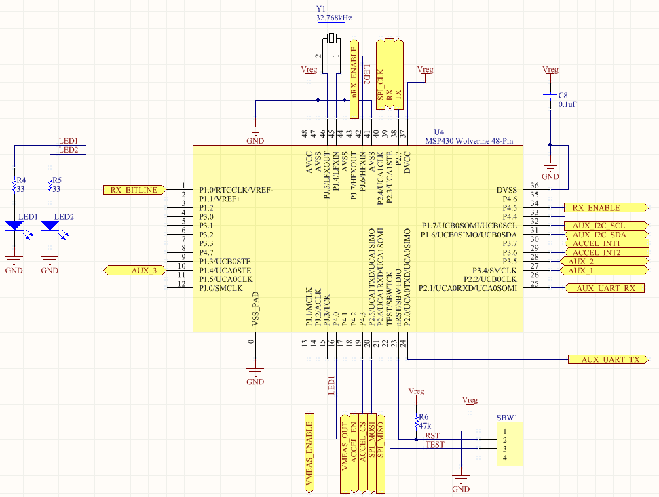
Digital section
Precision reference crystal
Indicator LEDs
MSP430FR5969
“Wolverine”...
Still in prototype phase.
Programming port (2-wire)

Slide 33
MSP430FR5969 “Wolverine”
Texas Instruments’ latest MSP430 offering
Flash is entirely replaced by FRAM
FRAM Write: 100x less energy per bit
A bit behind schedule….
Production quantities now scheduled for June 2014 availability.
Prototypes available, but with some HW bugs.

Slide 34
Firmware Walkthrough

Slide 35
MSP430 - Review
Historically the lowest power devices available
Typical ~0.1µA sleep mode current
Decent µA/MHz numbers
Rapid low power mode entry/exit (very important)
Power-optimized peripherals
TI has a track record of pushing the envelope in low power design! Learning the MSP430 is a good time investment.

Slide 36
MSP430 - Review
16 bit, RISC ISA, 4 stage pipeline
Several series of interest to us
F2xxx (flash): Simplest and most stable series
F5xxx (flash): Adds features:
HW multiplier
CRC generator
Advanced clocking features (FLL, etc)
Extended ISA, etc.
FR5xxx: FRAM-based MCUs, most notably FR5969

Slide 37
Learning from the WISP 4.1
Non-modular
1500-line mixed C and ASM file...
Unclear how to extend/add functionality
Seemingly simple tasks took lots of development time
WISP 5 addresses these issues!

Slide 38
WISP 5 Firmware Overview
wisp-base
The standard library for WISP 5. Compiles as a static library.
This library contains everything needed for an application to:
Initialize and configure the WISP
Talk to an RFID reader
Use all WISP peripherals
And that’s all!
Functionality is entirely defined by the application.
All applications reference the one static library above, and are compiled as executable.

Slide 39
WISP 5 Firmware API
WISP_init()
Set up GPIO and peripherals
Initialize the RFID state machine
WISP_getDataBuffers()
Initializes a client-owned struct which has pointers to important RFID related memory buffers
EPC buffer, read buffers, write buffer

Slide 40
WISP 5 Firmware API
WISP_registerCallback_XXX()
Register a callback for a particular event (XXX):
Call a client function after one of these events happens:
ACK: Call a client function after an ACK reply is sent
READ: Call a client function after a READ reply is sent
WRITE: Call a client function after a WRITE acknowledgement is sent
BLOCKWRITE: Call a client function after a BLOCKWRITE acknowledgement is sent
Client can then read or update data buffers

Slide 41
WISP 5 Firmware API
WISP_setMode()
Determine what sort of reader commands the WISP will reply to (e.g., READ, WRITE,etc)
WISP_setAbortConditions()
Determine what events will cause WISP_doRFID() to return.
For instance, it can return only after a certain reader command has been responded to.

Slide 42
WISP 5 Firmware API
WISP_doRFID()
Begin talking to an RFID reader.
This function blocks, but can make callbacks to client code when certain events happen.
This function exits on conditions specified by user.

Slide 43
WISP 5 Firmware API
NOTE: All subject to modification!
Your input is important. Submit comments and bugfixes to our github page.

Slide 44
RFID Internals
“Black box”: RFID state machine
Lots of development time goes into this
Most WISP users should not need to touch this
Protocol hackers will want to understand this
RFID State Machine
this Happy WISP Developer
ignores the contents of the black box
Simple Interface

Slide 45
EPC C1G2 Protocol
Standard for UHF RFID (868MHz / 915MHz)
Designed to inventory large numbers of low-complexity tags rapidly

Slide 46
EPC C1G2 Protocol
High-level overview
Reader-to-tag signaling
Amplitude-shift-keyed (ASK) modulation
Pulse interval encoding (PIE)
Timing parameters sent in preamble
Tag-to-reader signaling
Backscatter modulation: Load-shift keying (LSK)
WISP 5 uses biphase space encoding (FM0)
Medium access control (MAC)
Slotted Aloha

Slide 47
EPC C1G2 Protocol
EPC C1G2 Reader-to-tag command summary
Query, QueryRep (repeat), QueryAdj (adjust)
Set up parameters of an inventory round and ask tags to talk
Tags will respond (after slotting protocol) with an RN16 handle
Ack
Ask the tag to backscatter its EPC
Tag will respond with its EPC
Read, Write, BlockWrite
Read or write data from/to a location in the tag’s memory
Tag will respond with Read data and will acknowledge successful Writes and BlockWrites.

Slide 48
Interfacing with the Reader

Slide 49
Impinj Speedway: Reader Connectivity
Network interface
RFIDemo web application
SSH into RShell

Slide 50
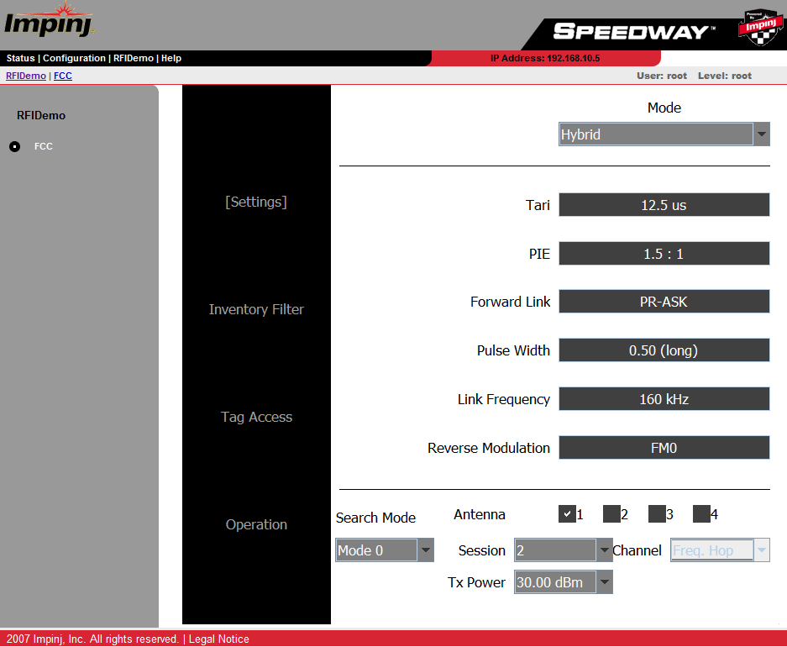
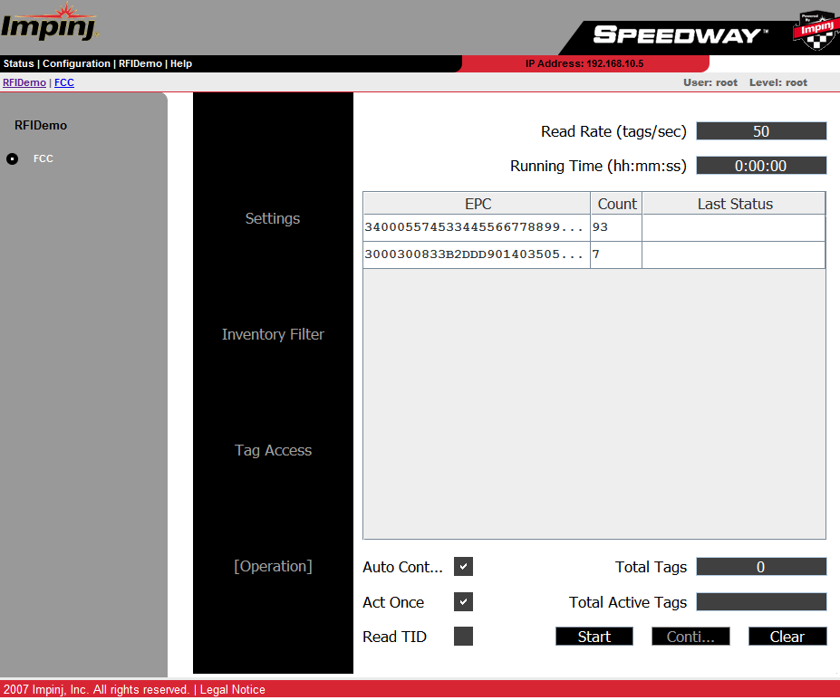
Impinj RFIDemo Web App

Slide 51
LLRP & SLLURP
Low Level Reader Protocol: A standard protocol for interfacing with UHF RFID readers
SLLURP: A simplified interface for using LLRP readers!

Slide 52
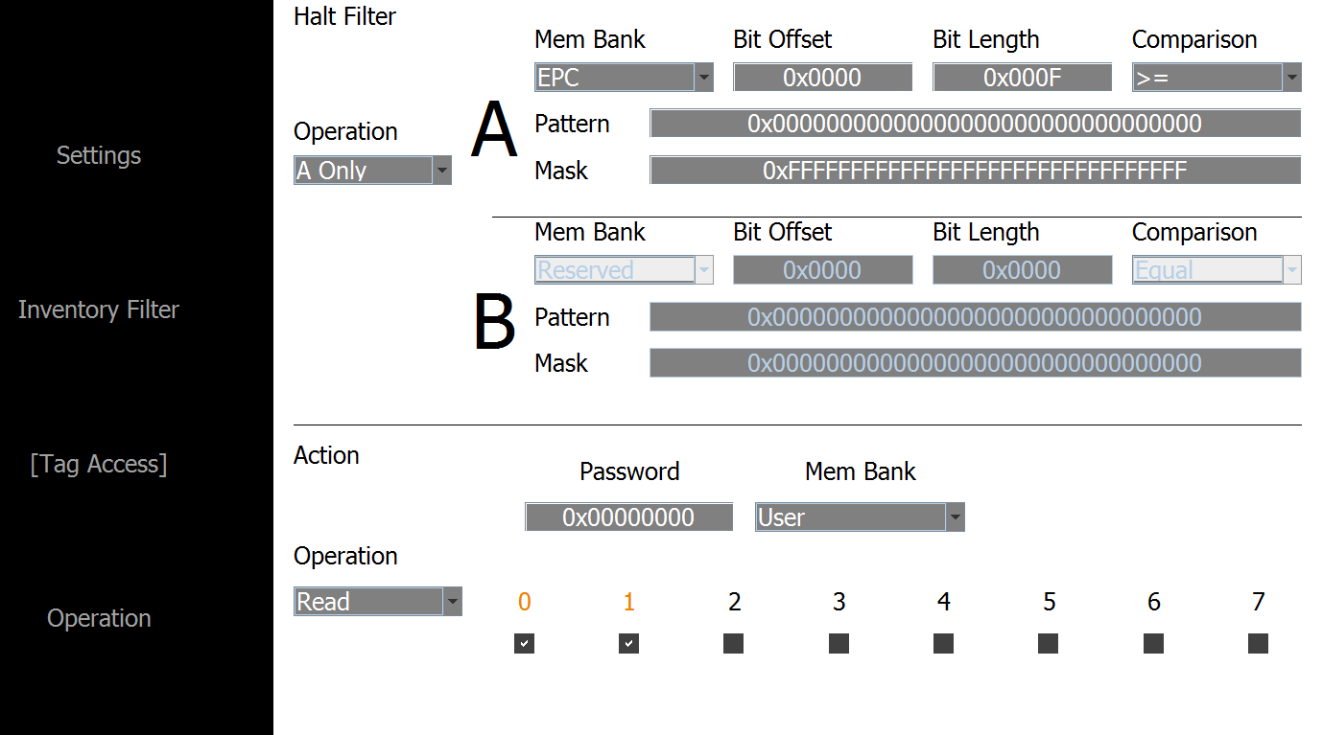
READ-ing and WRITE-ing tags
From Impinj RFIDemo:

Slide 53
Live Demos: Application Development

Slide 54
Live Application Development to Report Supply Voltage
Using Resistive Voltage Divider & ADC
Configuring ADC module Registers
Reporting 8-bit ADC Result and Plotting that

Slide 55
Applications
Ability to calculate the amount of charge remaining on the tag while the tag is powered.
Measuring amount of energy that a specific task needs.
Based on remaining energy decide whether to perform a task or not.

Slide 56
Temperature Sensor and FeRAM
Temperature Sensor will report temperature
Maximum of temperature ever sensed will be stored in FeRAM
Application in data collection during a long period of time, say couple of years!

Slide 57
Write Command Demo
An LED will be flashed if a specific word is written to the tag.
Write command will give the tag the ability to be remotely controlled and switch between tasks easily from the reader side.

Slide 58
Designing for Low Power

Slide 59
Power Measurement Techniques
Challenges
High dynamic range (nA’s to mA’s)
Rapid fluctuation (µs)

Slide 60
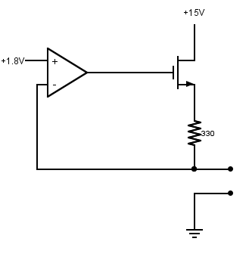
Power Measurement Techniques
Most direct method:Source-Measure Unit (SMU)
Build your own!

Slide 61
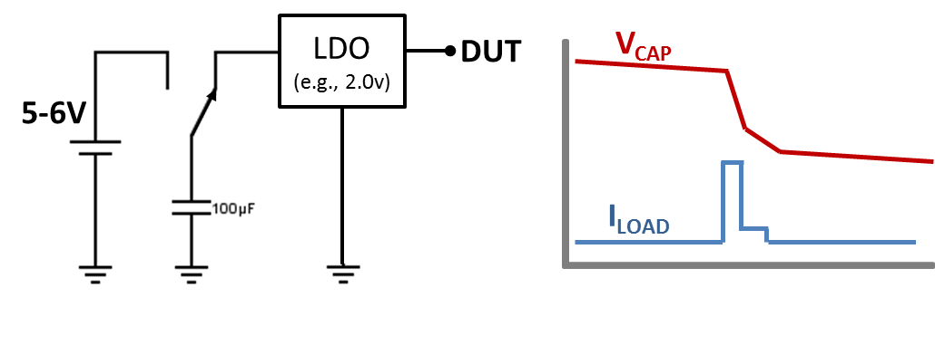
Power Measurement Techniques
Most realistic method: Capacitor charge depletion

Slide 62
Optimizing for power: Things to avoid in low power FW
Math (without HW acceleration)
NVM access
Polling/delay loops
Floating inputs
Leaving stuff on all the time!

Slide 63
Optimizing for power: Clocking tips
Fine grained control of clock frequency
Rapid modulation of clock frequency to optimize for efficiency can save lots of energy.
Raw computation is typically most efficient (instr/µJ) at the highest clock rate available.
Communication, sensing, and other tasks may be optimal at lower rates.

Slide 64
Atomic Workloads
Atomic Workload (indivisible workload)
A computational or other workload that must be either accomplished or aborted in one contiguous run cycle.
Energy requirement dictates size of storage capacitor.
For form-factor devices, we want this very small!
Lots of interesting work to do in this area!
Bit-by-bit backscatter, MementOS, etc

Slide 65
THANK YOU!
Q&A
Hardware handout / sign up
http://www.github.com/wisp/wisp5

